Slide 1
Efficient Data Presentation
Cezmi A. Akdis
Editor-in-Chief

Slide 2
How to present your data
in a talk
in an article

Slide 3
Number of slides
1 slide per minute excluding the title
and acknowledgements slides
10-minute presentation should have max 12 slides

Slide 4
Design
Keep a consistent design throughout the whole presentation
  Select Slide Master before you start preparing
  your presentation, then stick to it
  Changing styles distracts attention
  Select a modest design only if you really need one

Slide 5
Amount of text
Do not include large amounts of text on the slide
Maximum 30 words per slide, max 6 lines
Do not show complete sentences on the screen
and then simply read them

Slide 6
Text size
Recommended 24-32 points
Not smaller than 18 points even in graphs
Title up to 54 points

Slide 7
Fonts
Keep consistent font style throughout the whole presentation
Use common easy-reading fonts
Avoid sophisticated fonts
Use bold text instead of CAPITAL LETTERS
Arial
Calibri
Times New Roman
Trattatello
Embassy BT
Giddyup

Slide 8
Animations
Use where necessary
Animate bulleted points to appear one at a time
and then speak to each point in turn
Once you move on to the next point, the previous point should fade to a less prominent color if you leave it on screen

Slide 9
Animations
Too fancy animations or slide transitions
should be avoided, unless they serve a specific purpose
Text from the left
Text from the right
Swiveling text

Slide 10
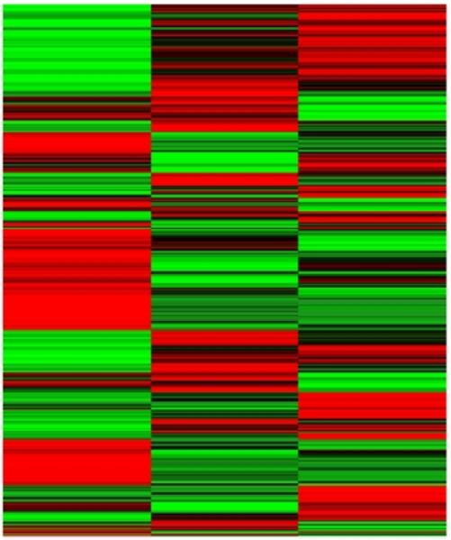
Colours
Avoid strong primary colours
Consider colour-blindness
green
almost impossible to read text
if some these combinations are used
red

Slide 11
Logos
Although some institutions insist on showing
their logos on every slide…
…corporate logos should be restricted to first
and last slides, if possible

Slide 12
Too busy slides
Good for a publication,
not for a presentation
Notes:
Arebro et al., Allergy, 2019, ahead of publication

Slide 13
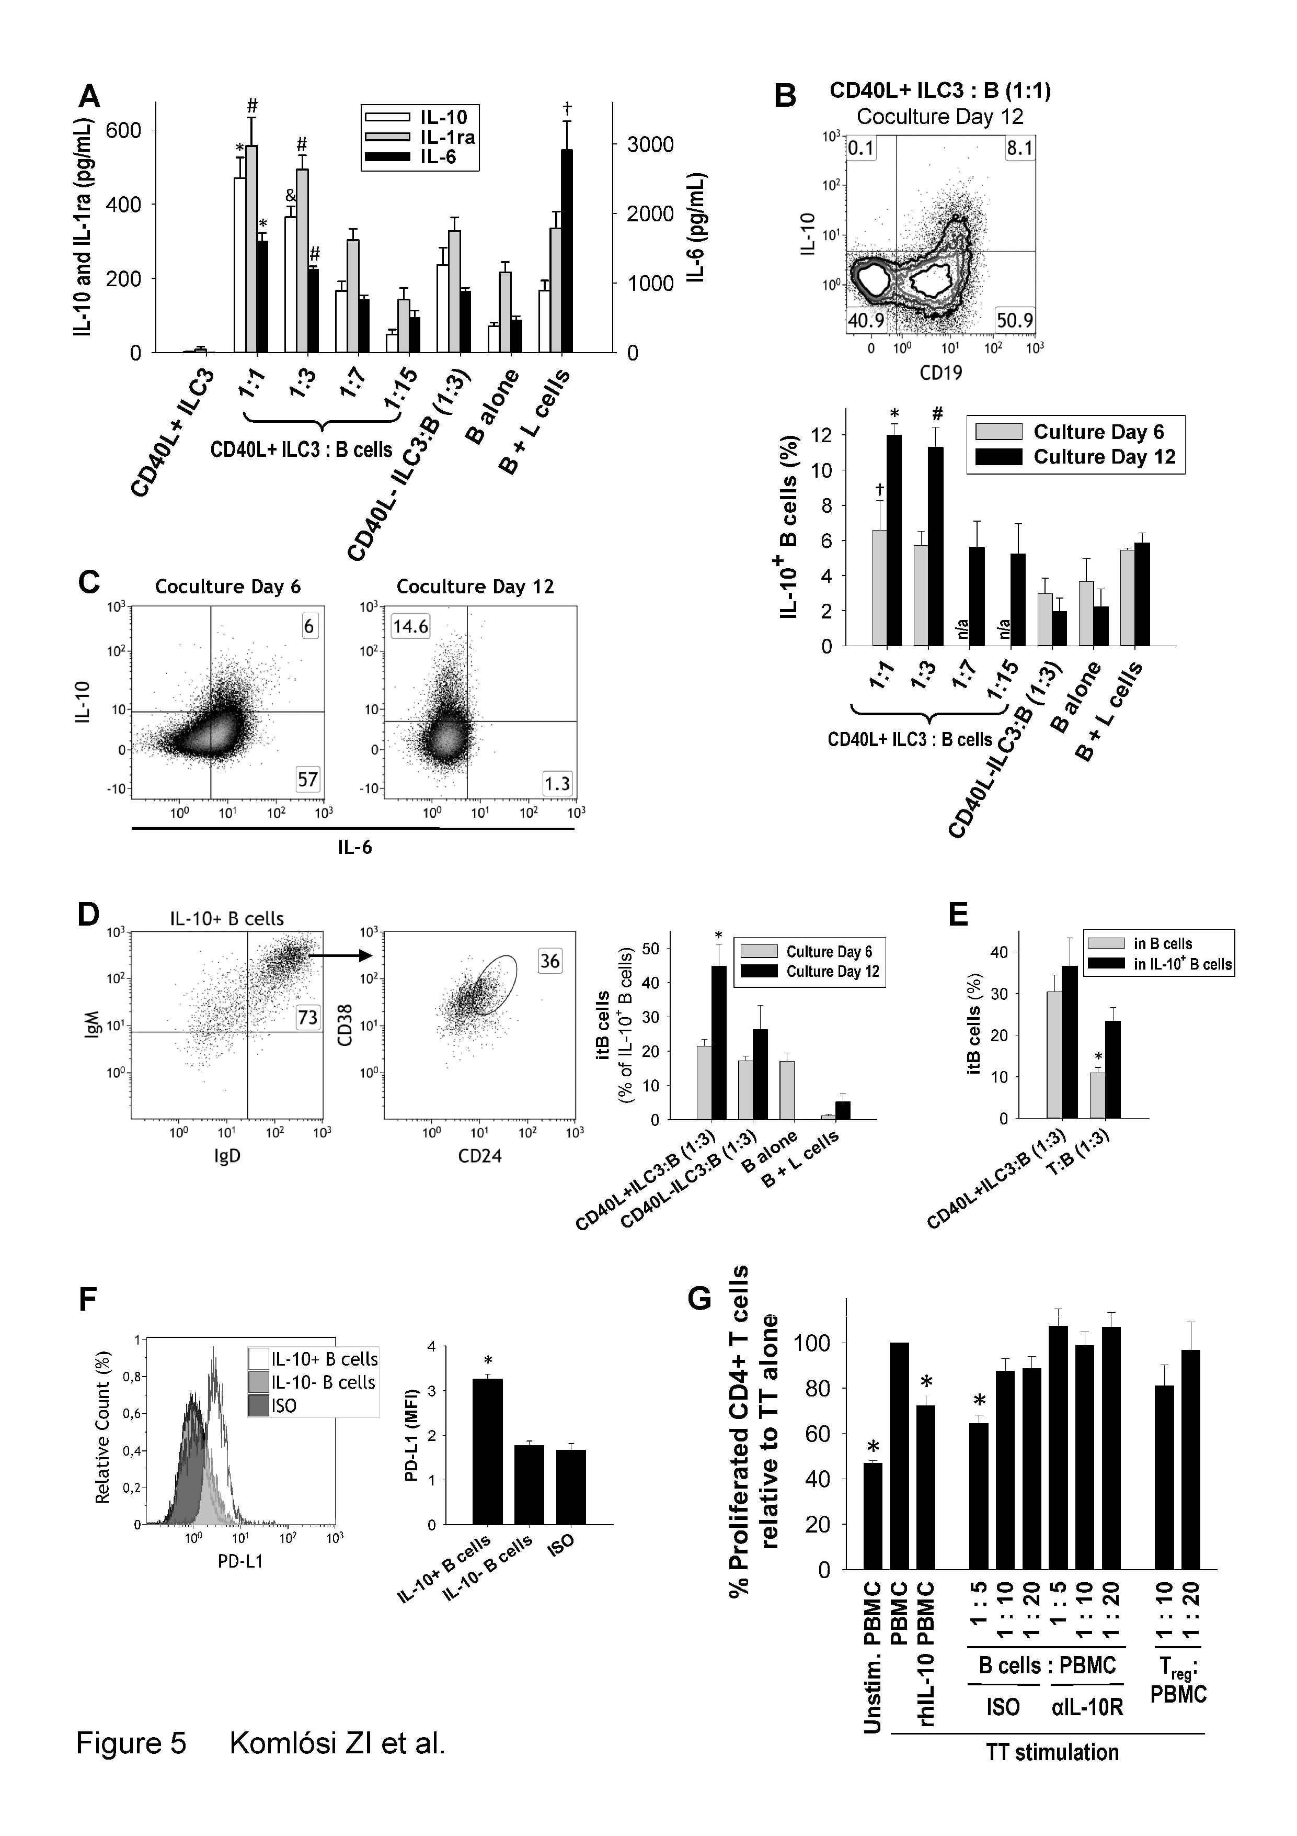

Slide 14
Use a descriptive title

Slide 15

Blurred images

Slide 16
How to present your data
in a talk
in an article

Slide 17
Title
Always use descriptive title with a message
such as
“Increased Bronchial Epthelial Cell Metabolic Activity
in Asthma Exacerbations”
instead of
“Epithelial Cell Metabolic Activity in Asthma”
Avoid abbreviations if possible

Slide 18
Data demonstration
Try to demonstrate original data, as original as possible
Use novel imaging and video techniques
Always ask your friends, fellows, students
their impressions before publicly trying
new visualization techniques

Slide 19
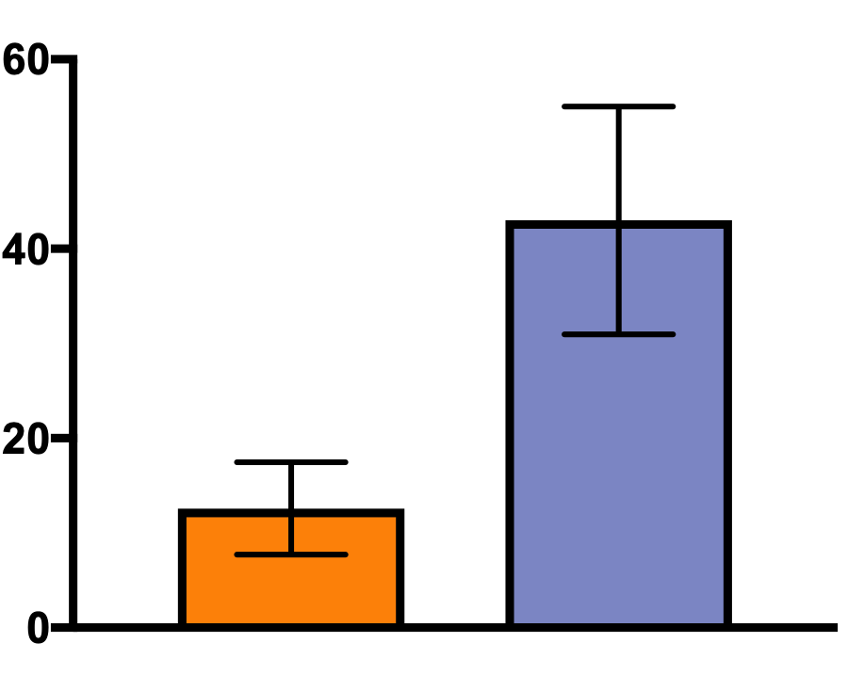
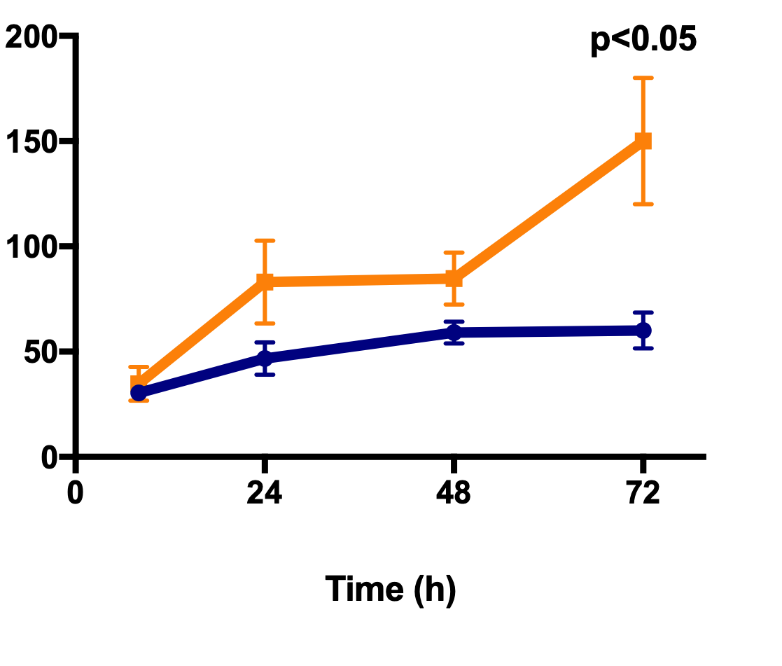
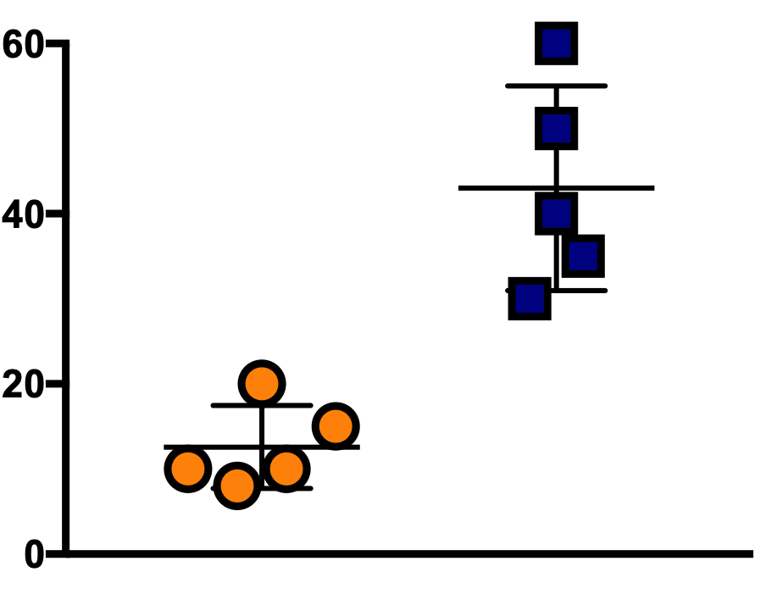
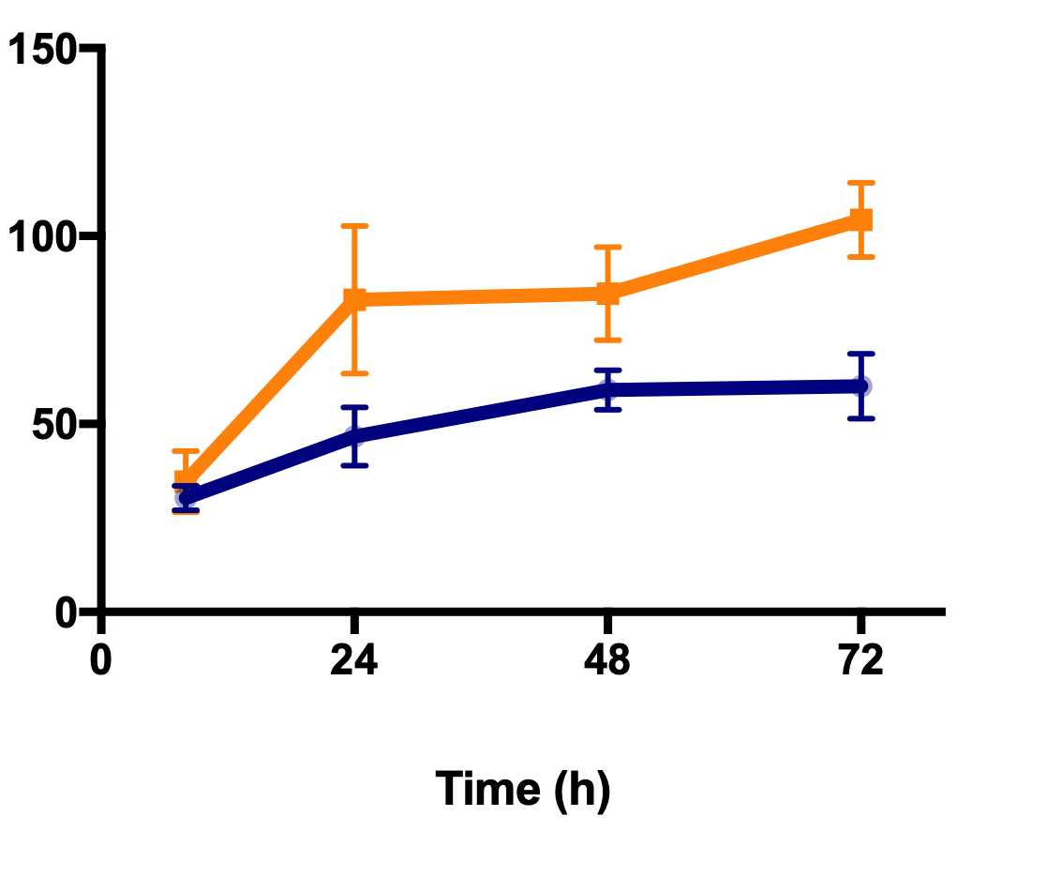
Data demonstration
Avoid bar graphs if possible
Instead try to use dotted graphs
Show time kinetics and dose response
Show statistics

Slide 20
Data demonstration
Do not show too many panels
Do not show unnecessary data

Slide 21
Consider print size
Calculate that the figure will be shrinked to 1/4, 1/8 of a page when printed

Slide 22
Use readable font size

Slide 23
Get rid of dead space

Slide 24
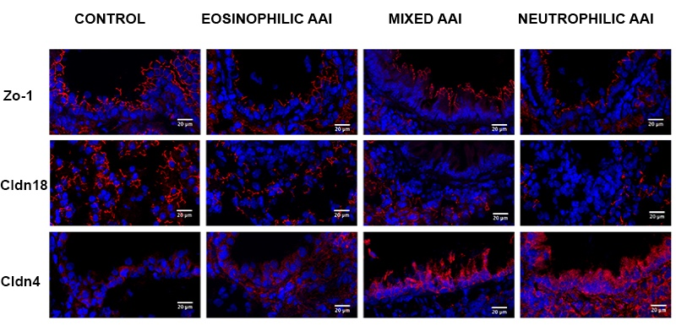
Data visualisation
Tan et al. Allergy. 2019; 74: 294– 307

Slide 25

How to present your data

Slide 26
GRAPHICS
EDITOR
Developing standardized
and uniform style
of Allergy graphics
Making illustrations based
on the authors’ drafts
Designing Covers
Communicating graphical requirements to the authors
Improving graphical abstracts and algorithms submitted by the authors

Slide 27

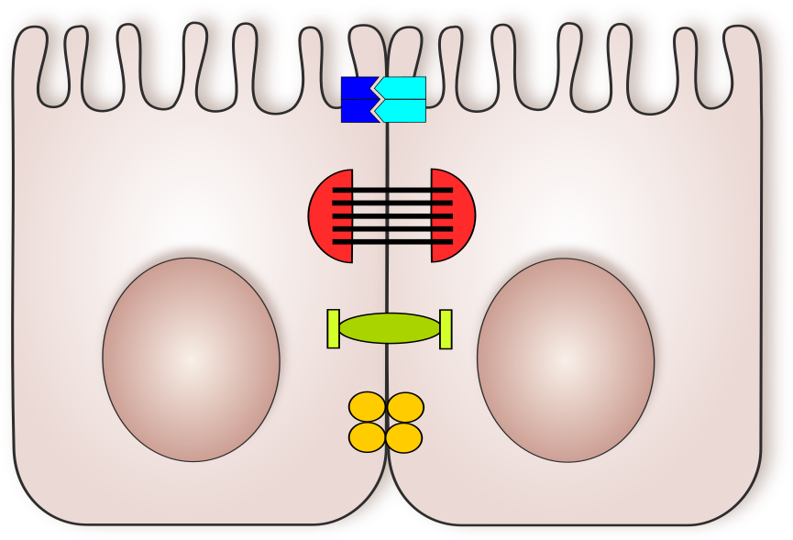



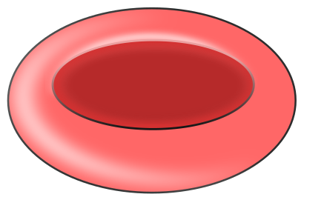
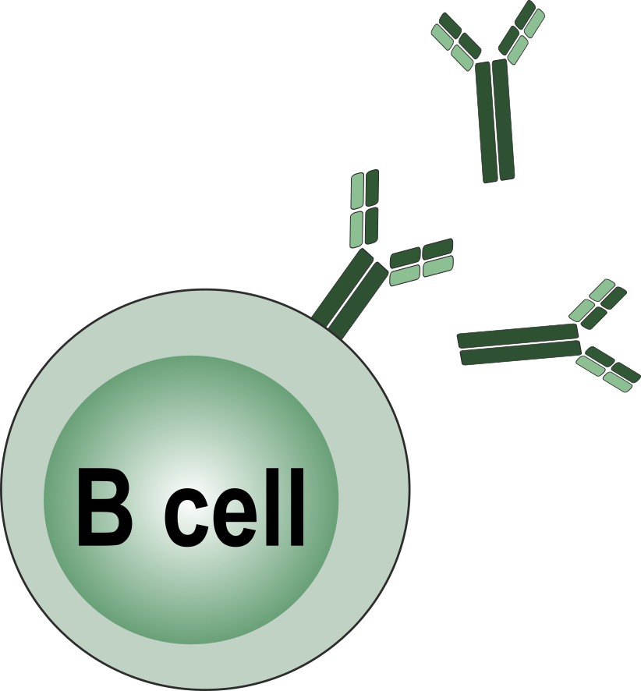




Graphics Collection

Slide 28








Graphics Collection

Slide 29
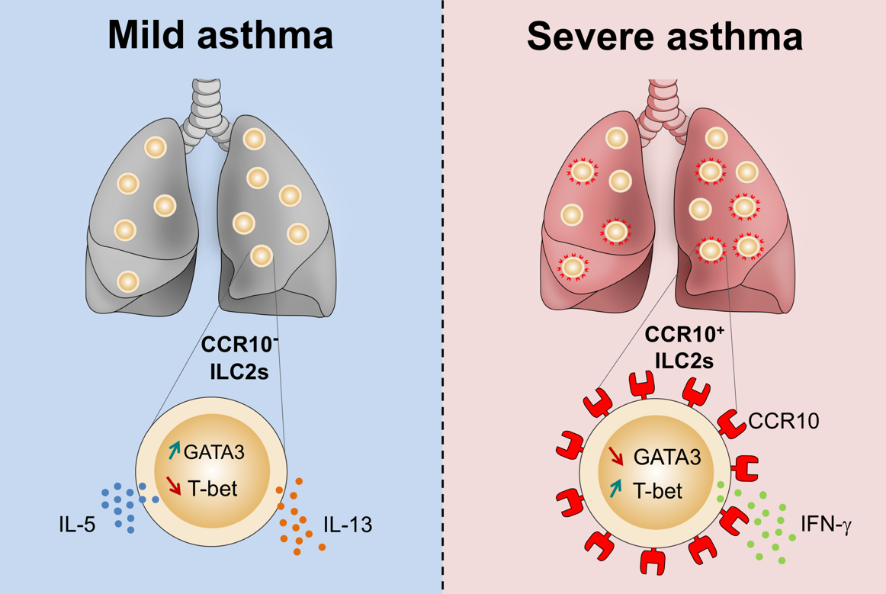
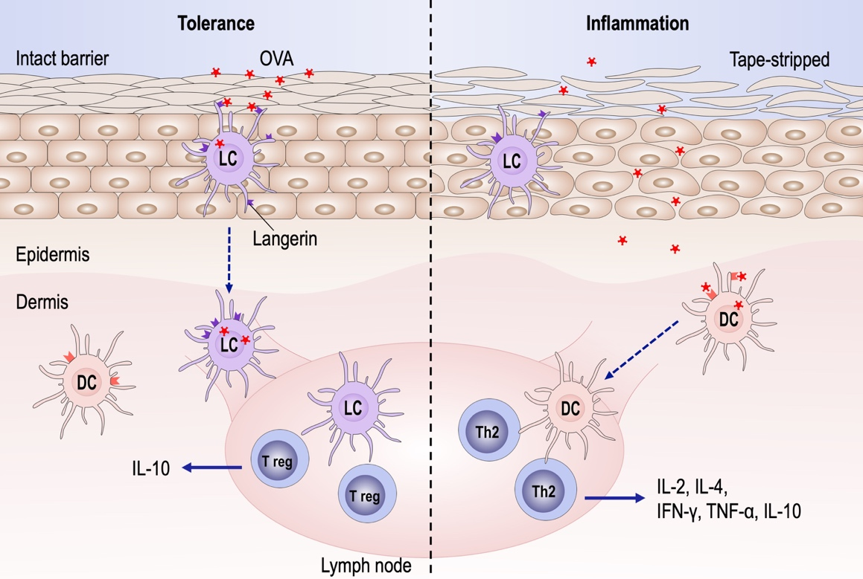
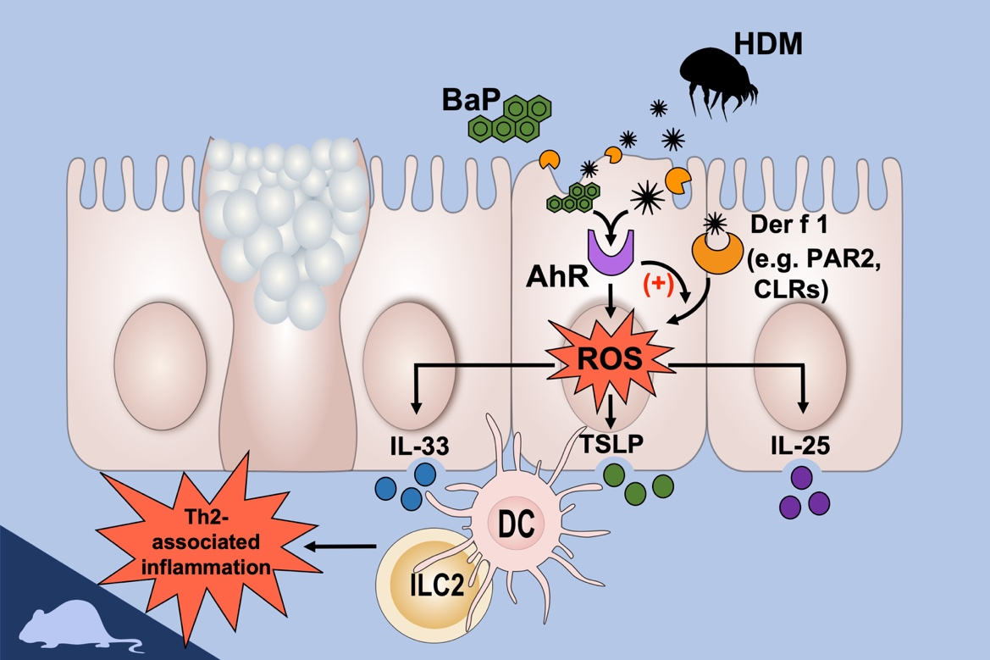
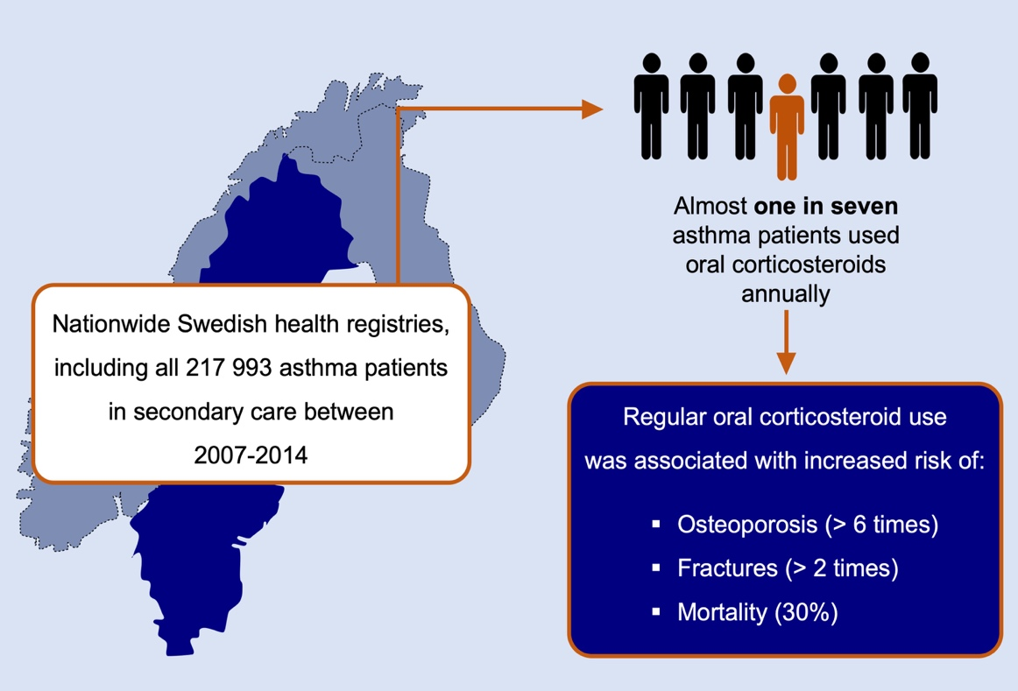
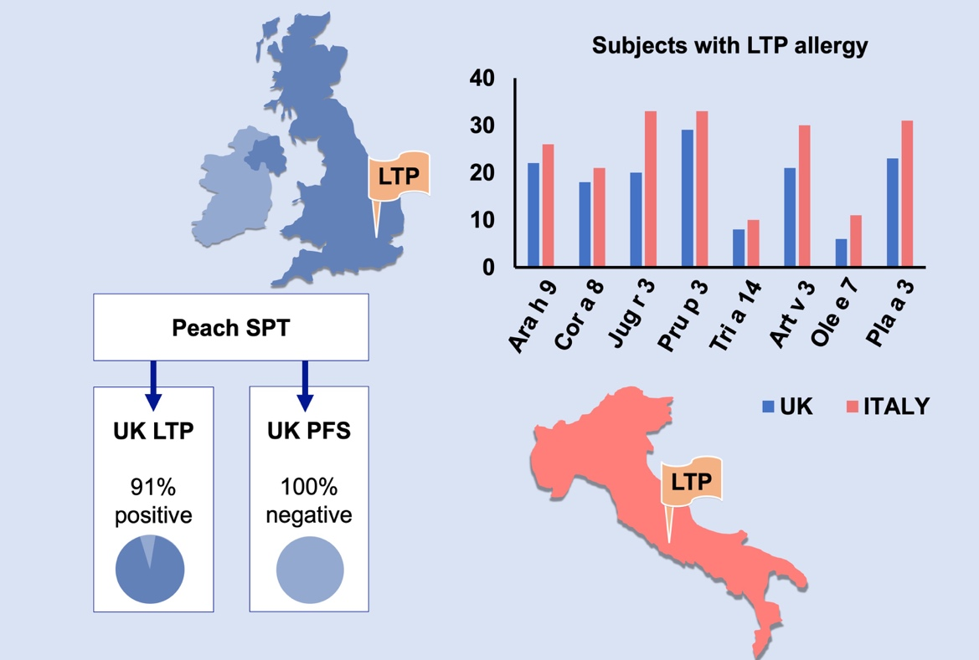
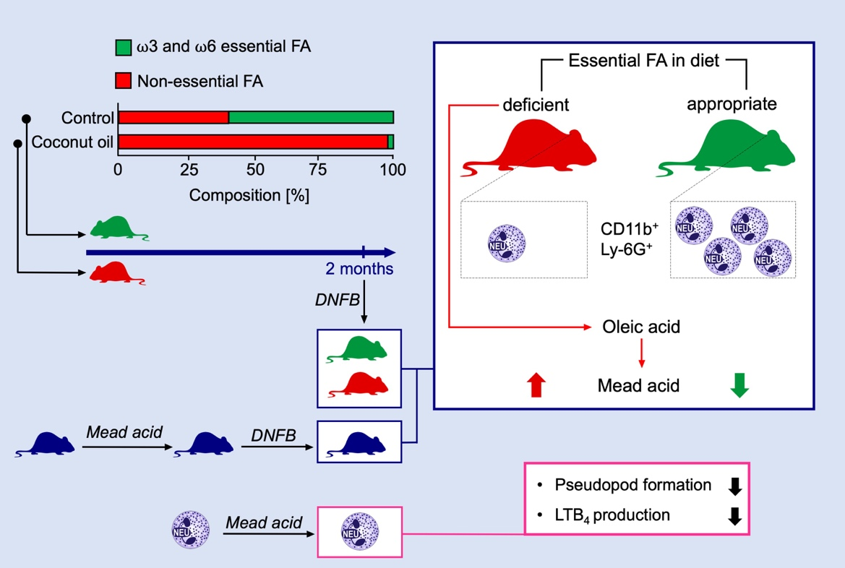
Graphical Abstracts

Slide 30
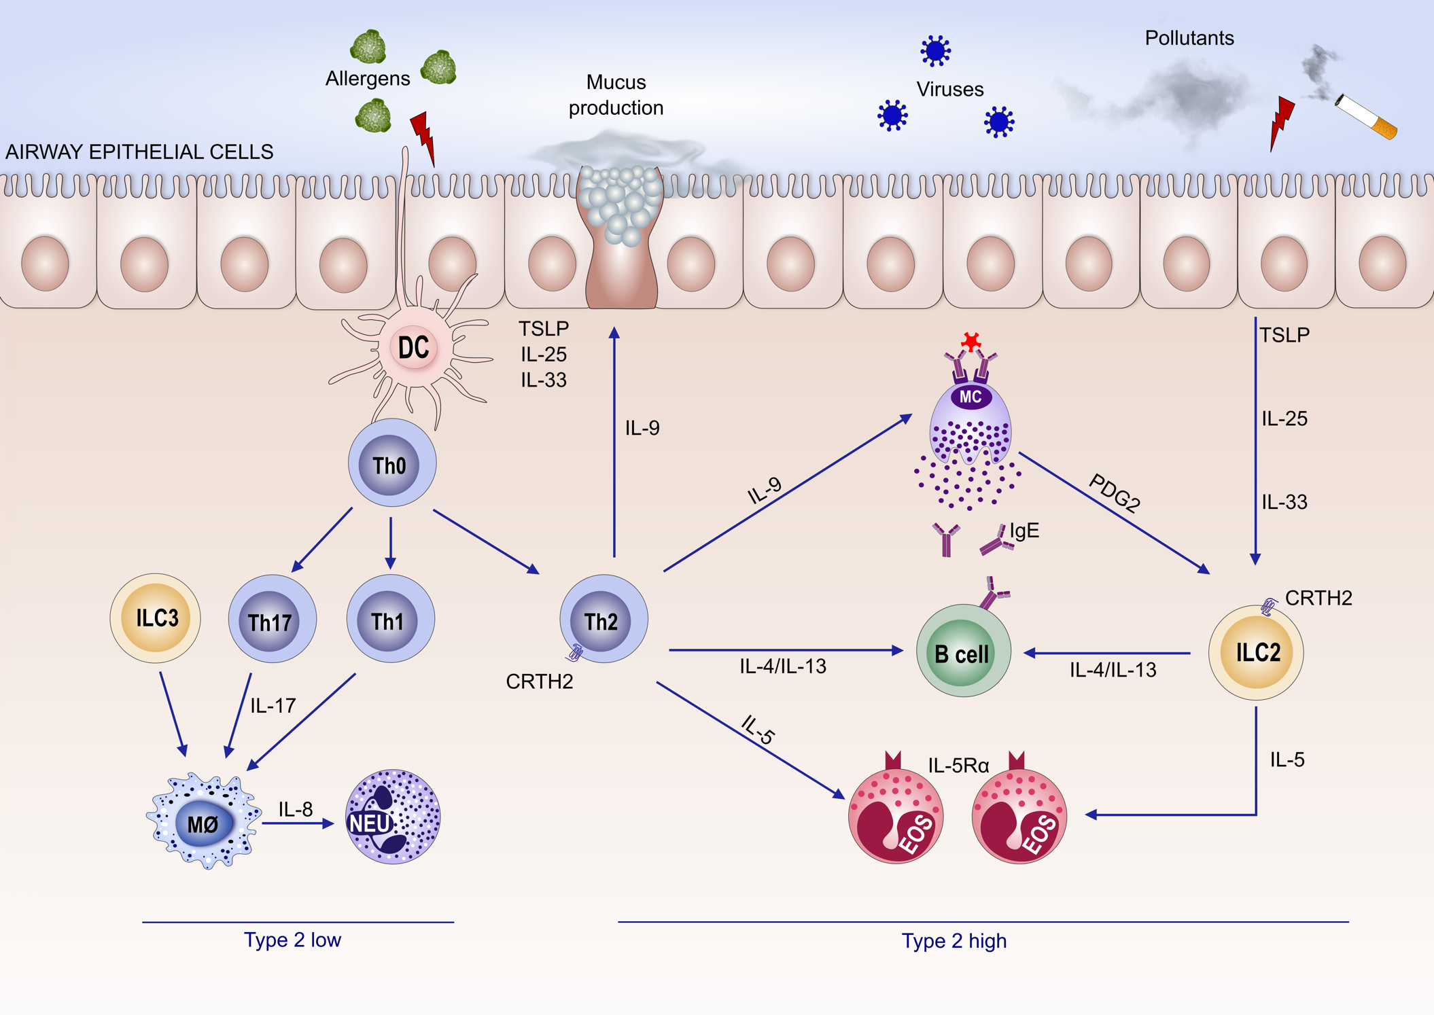
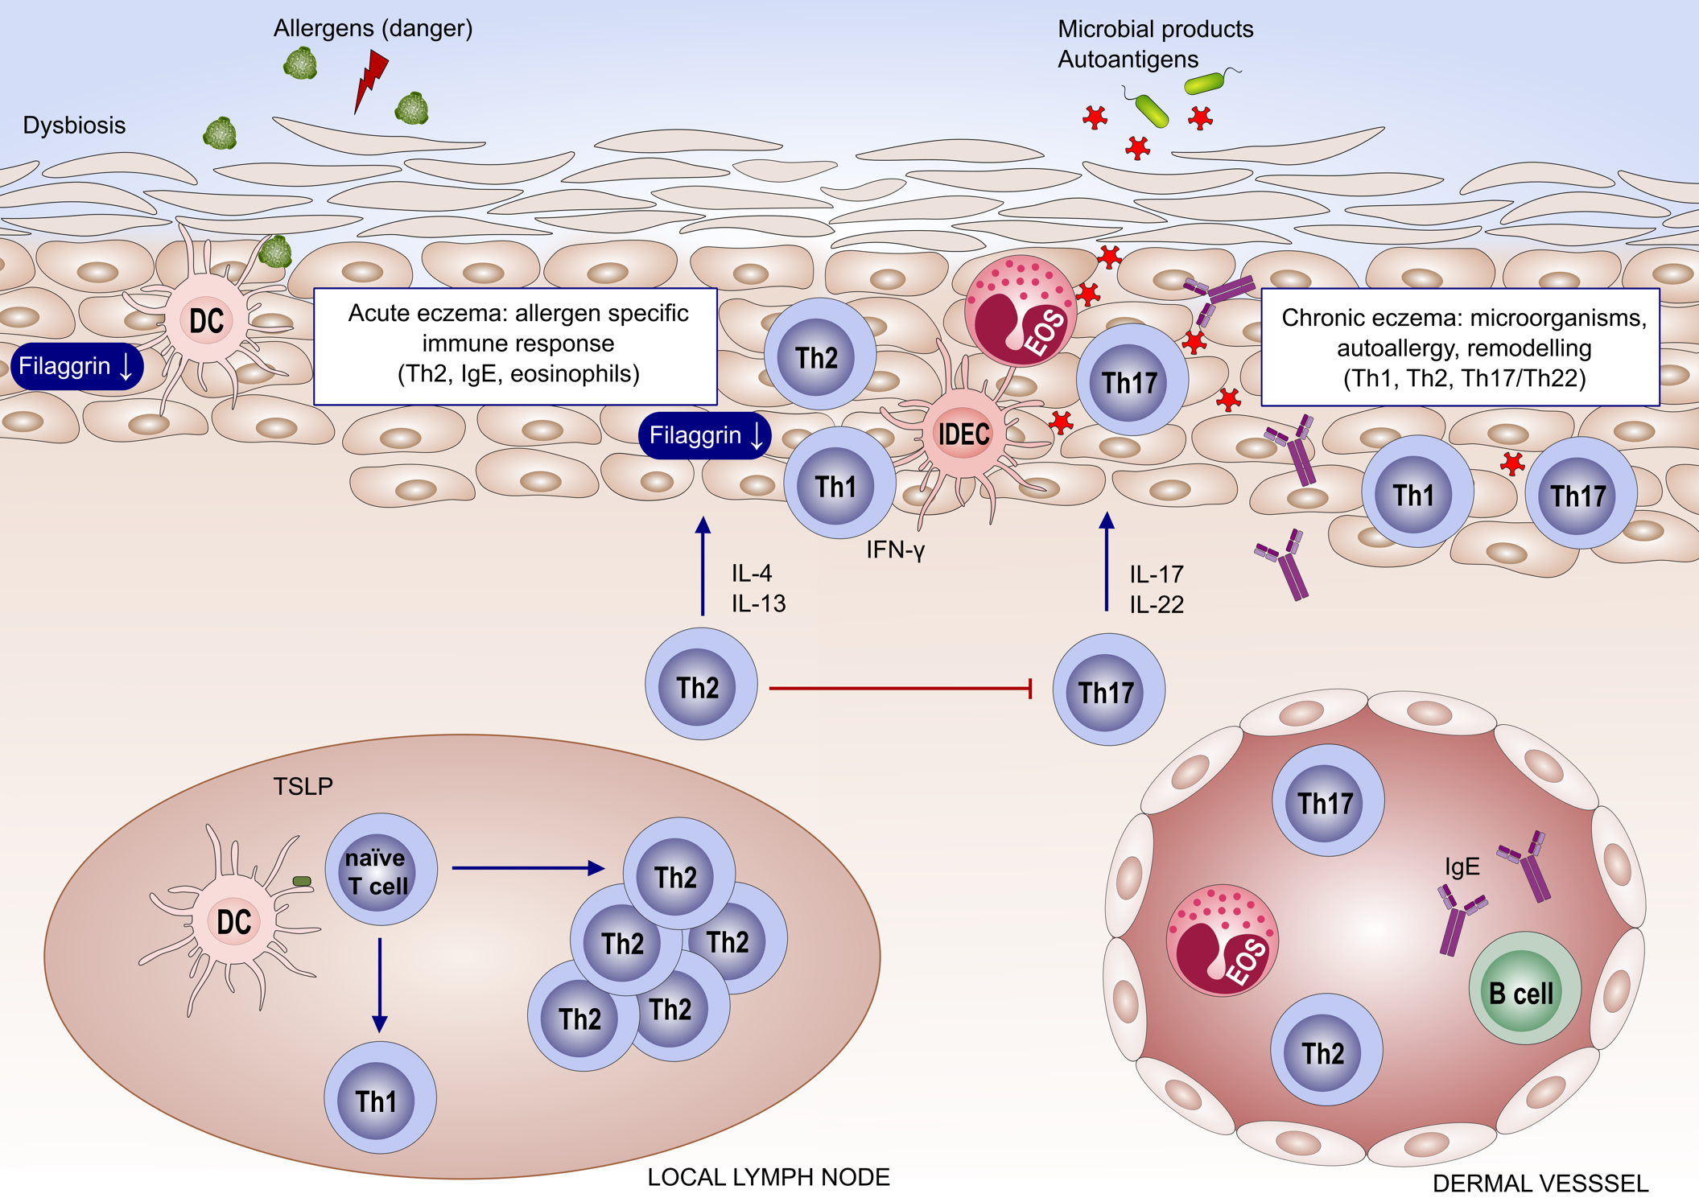
New Illustrations

Slide 31
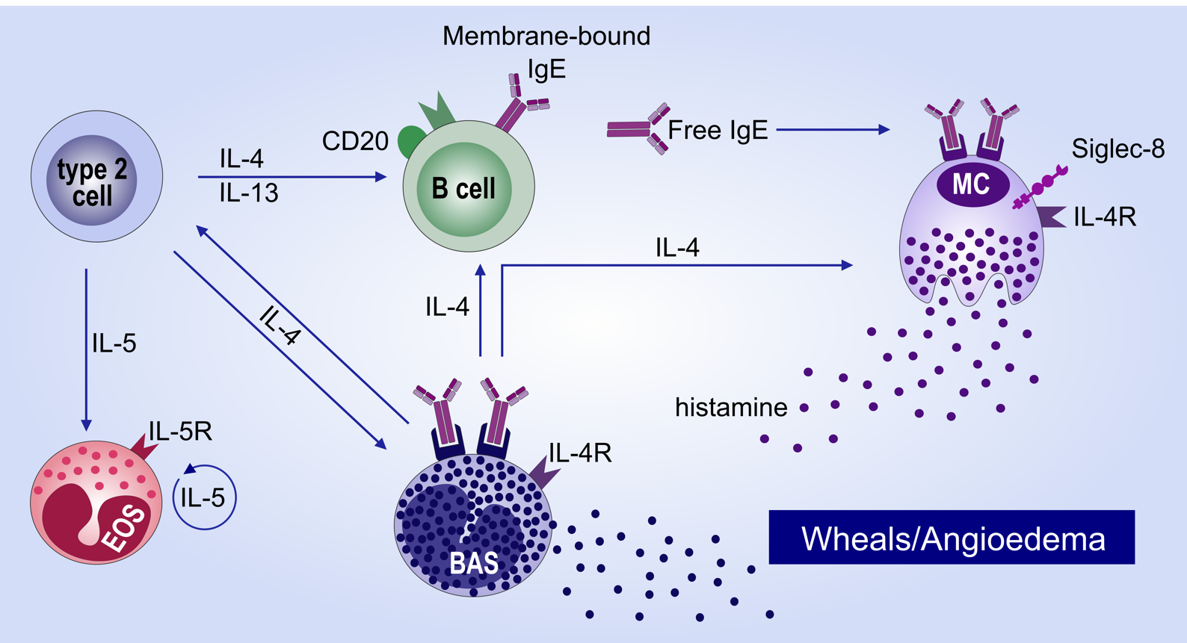
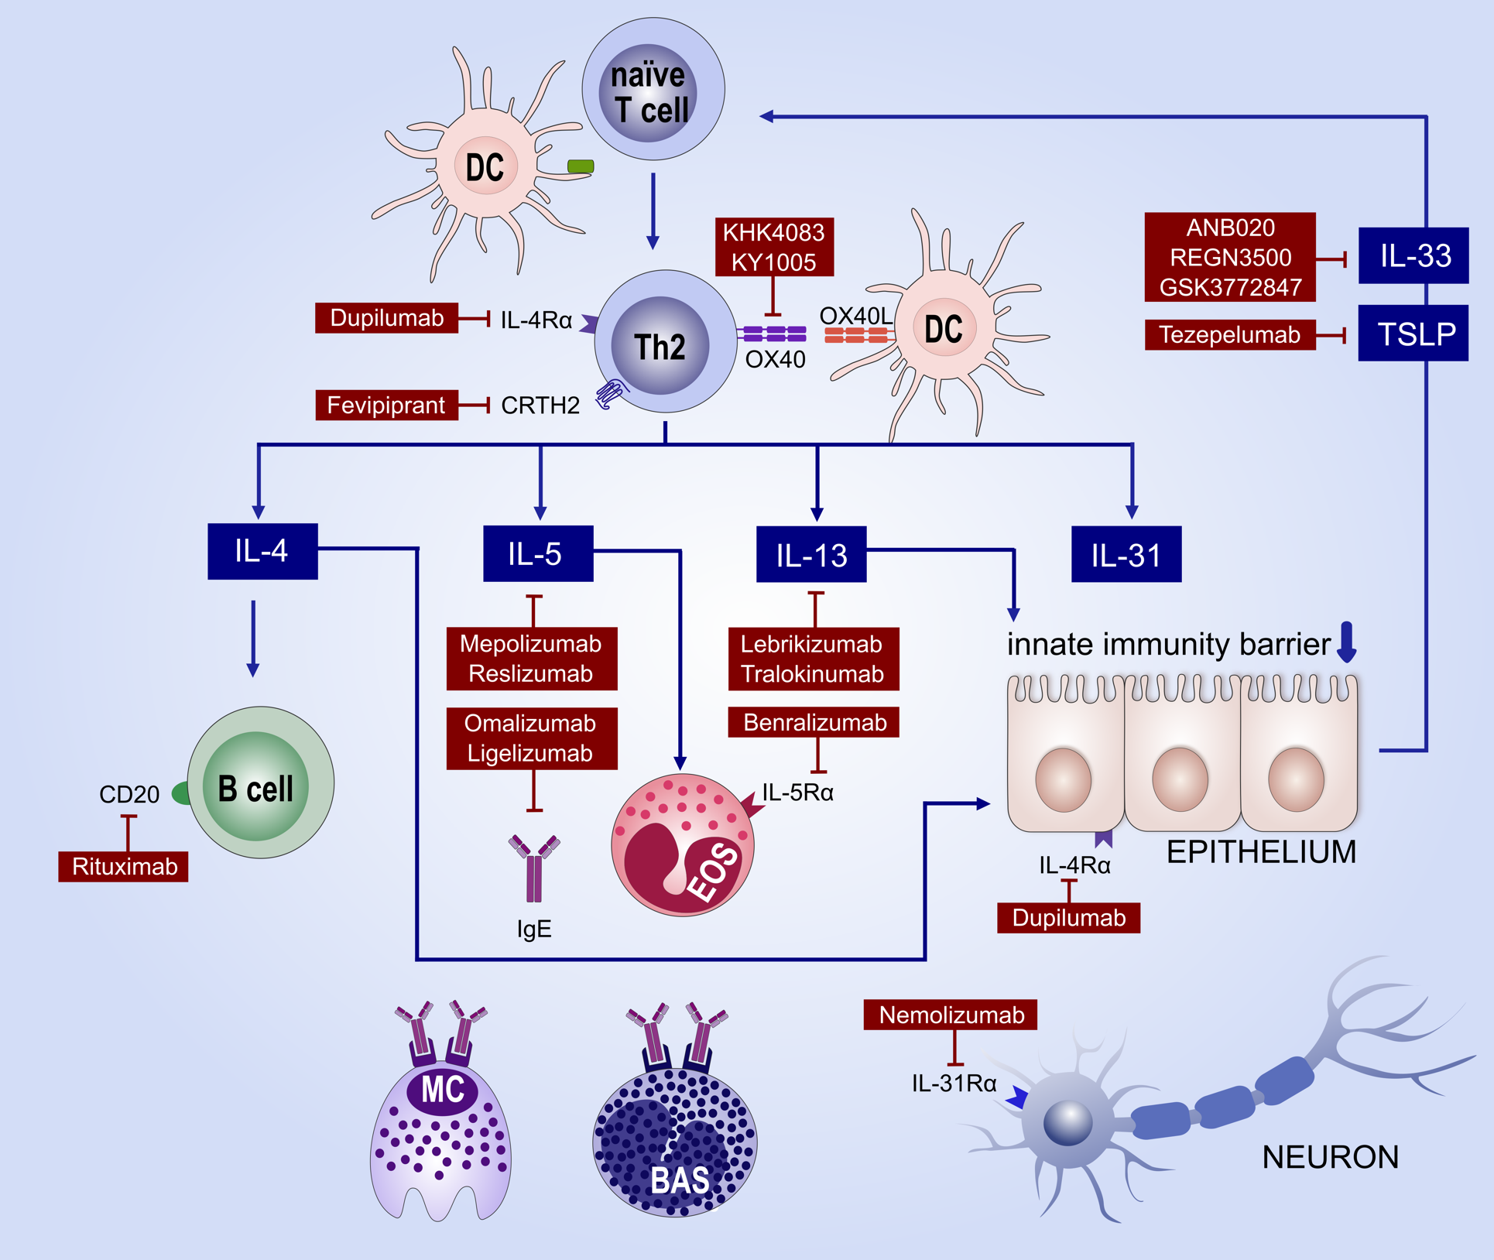
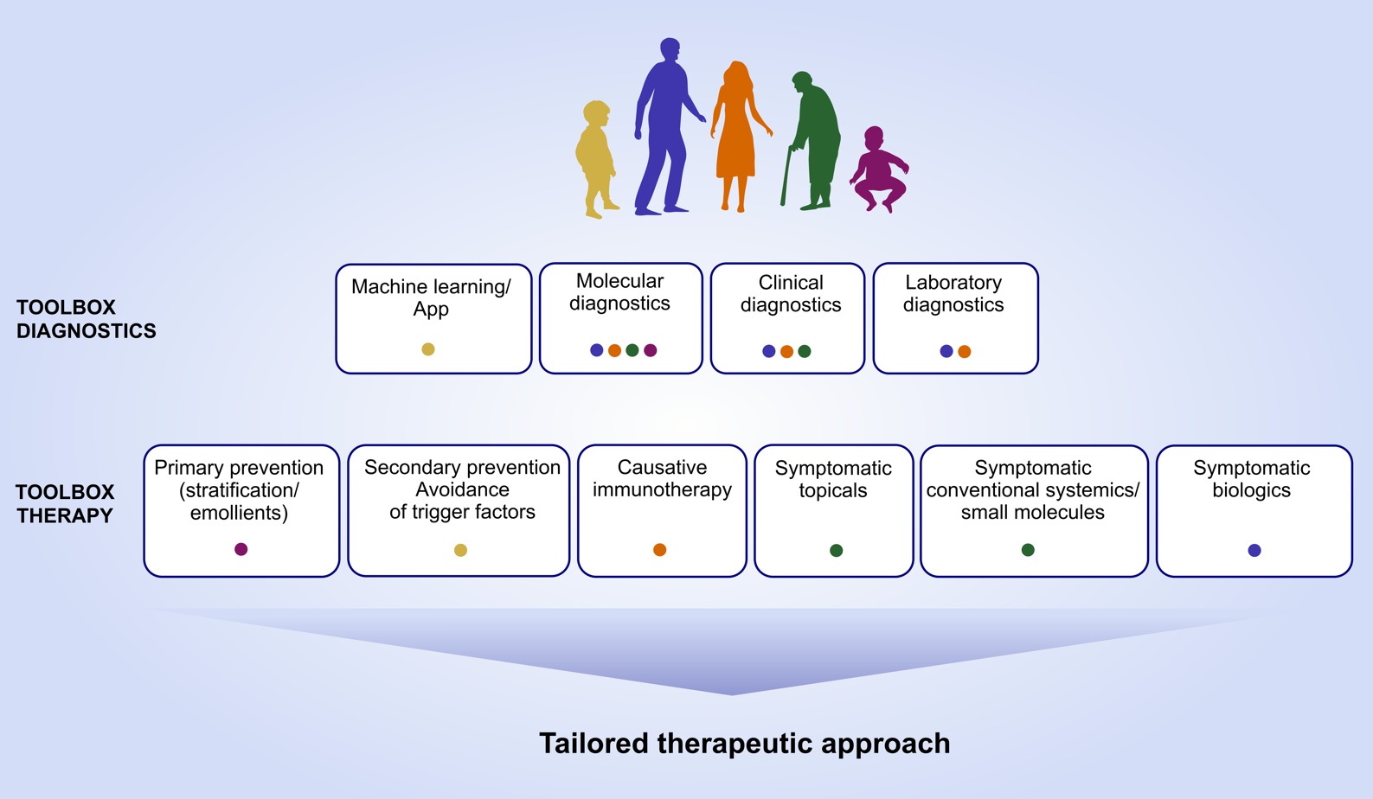
New Illustrations

Slide 32
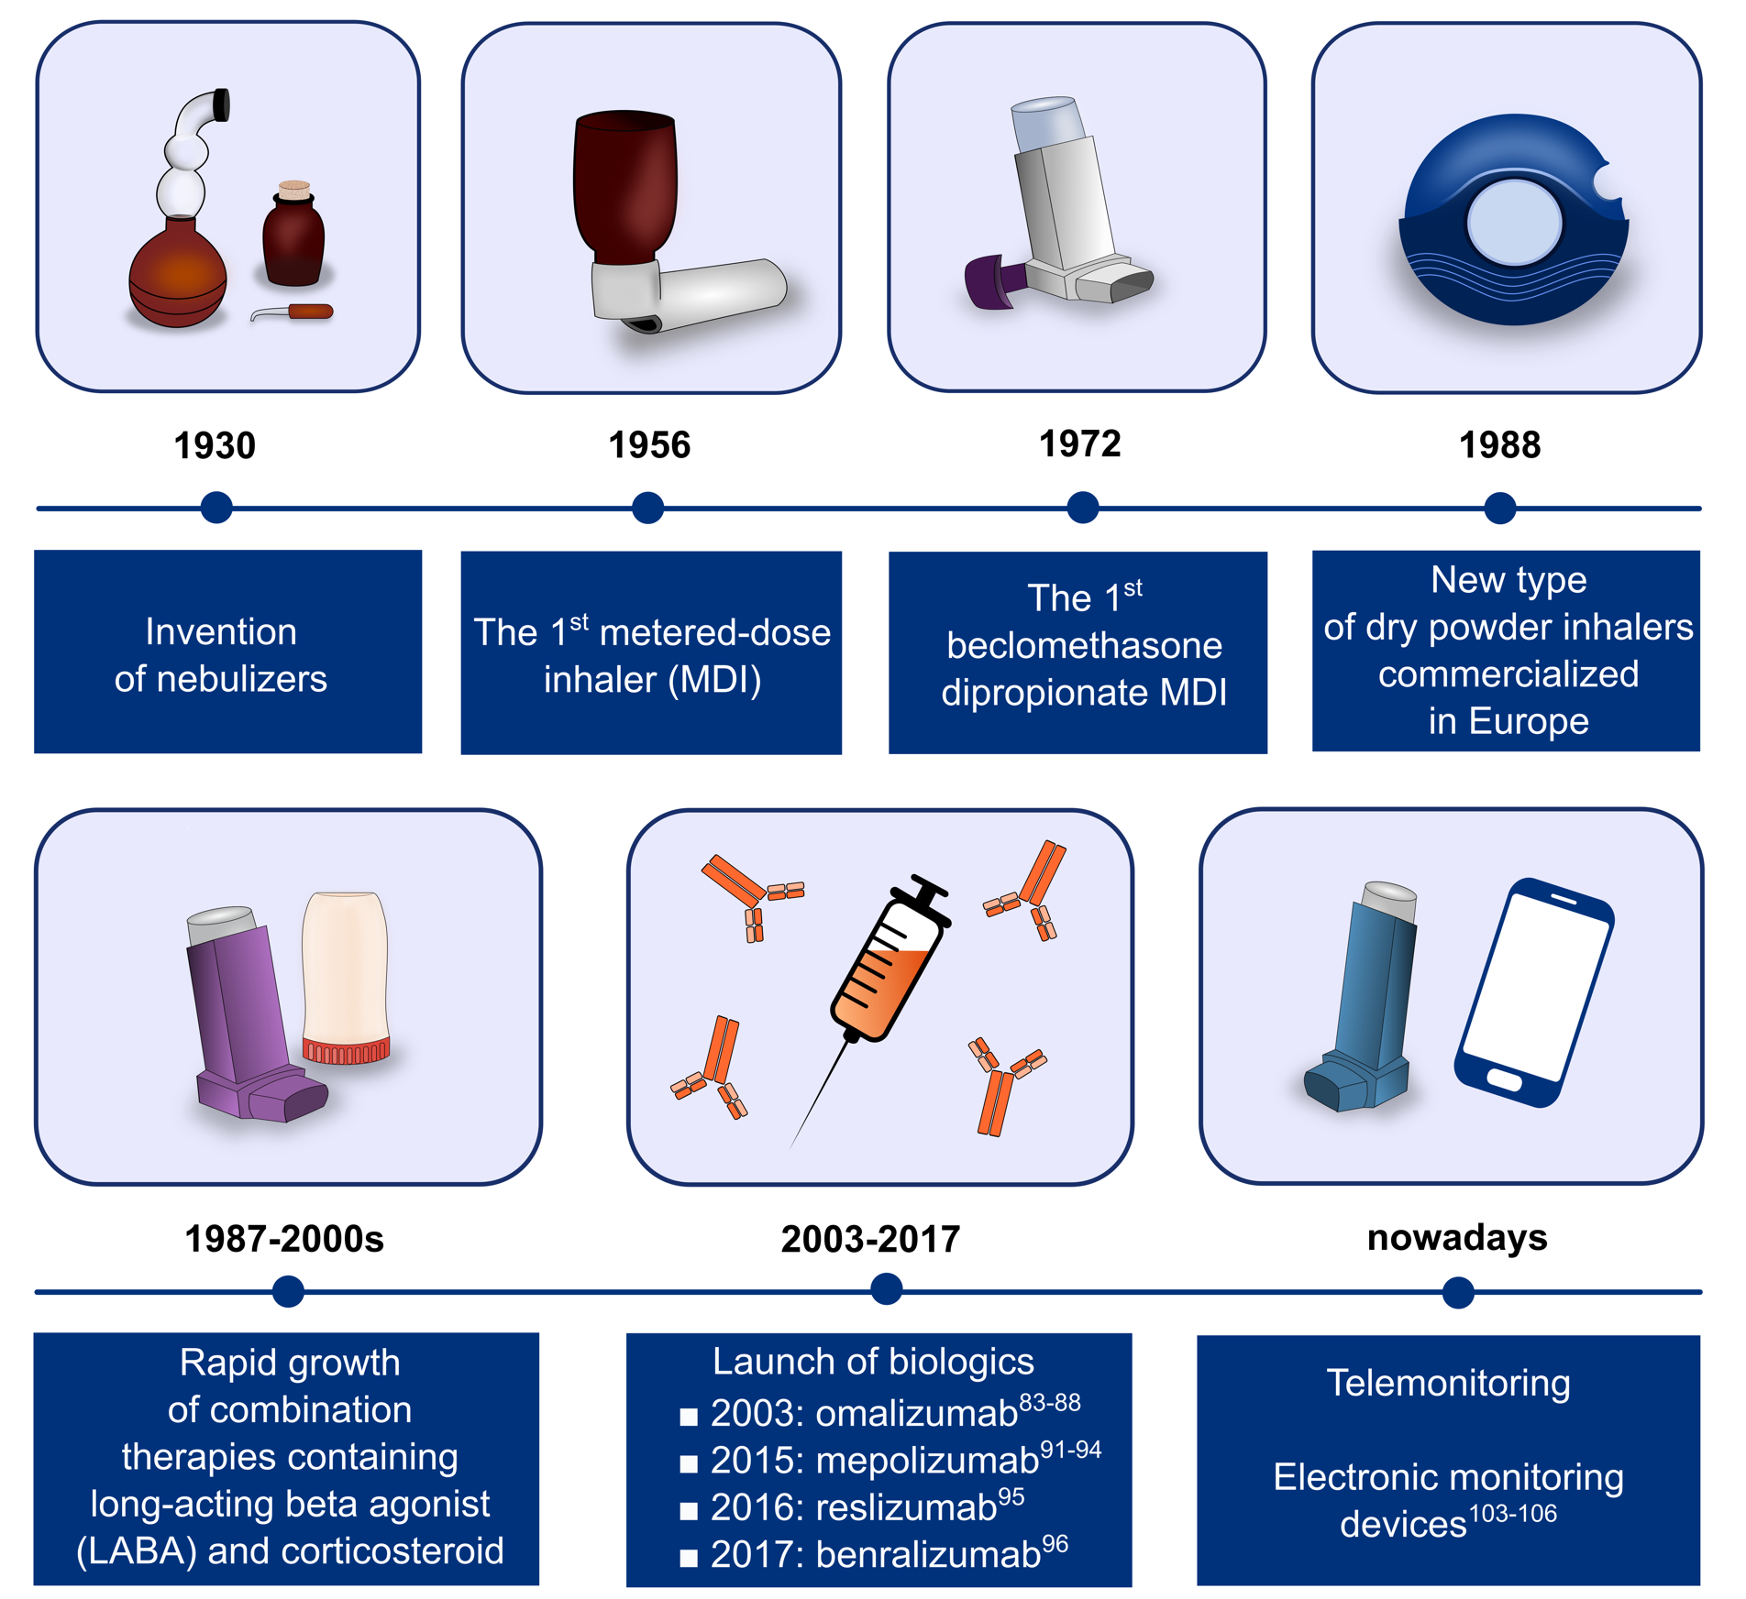
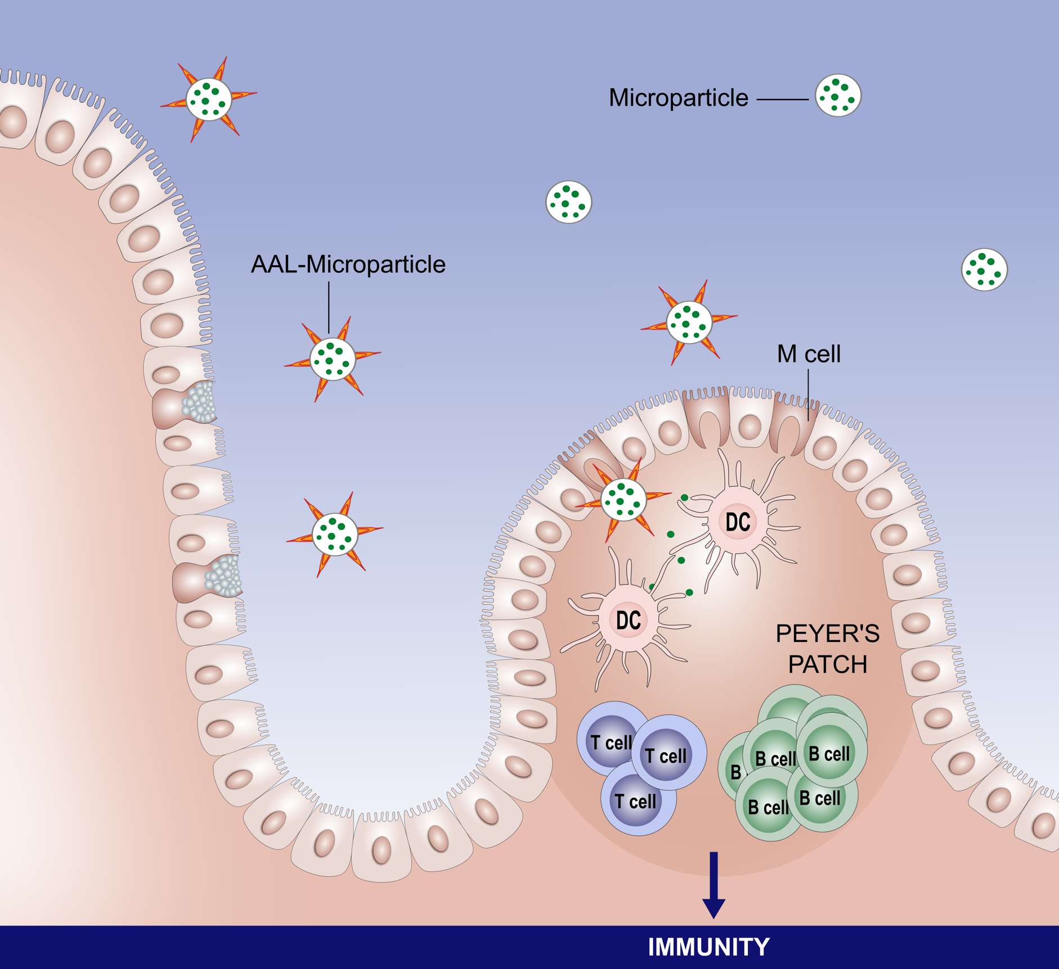
New Illustrations

Slide 33
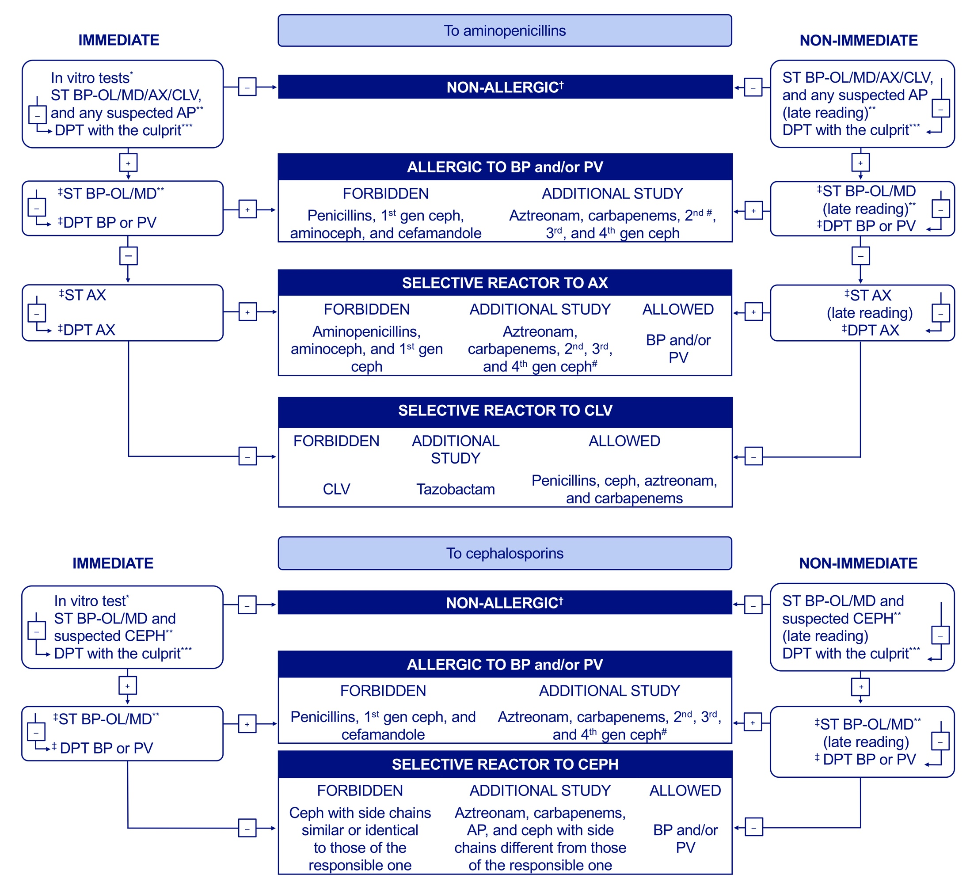
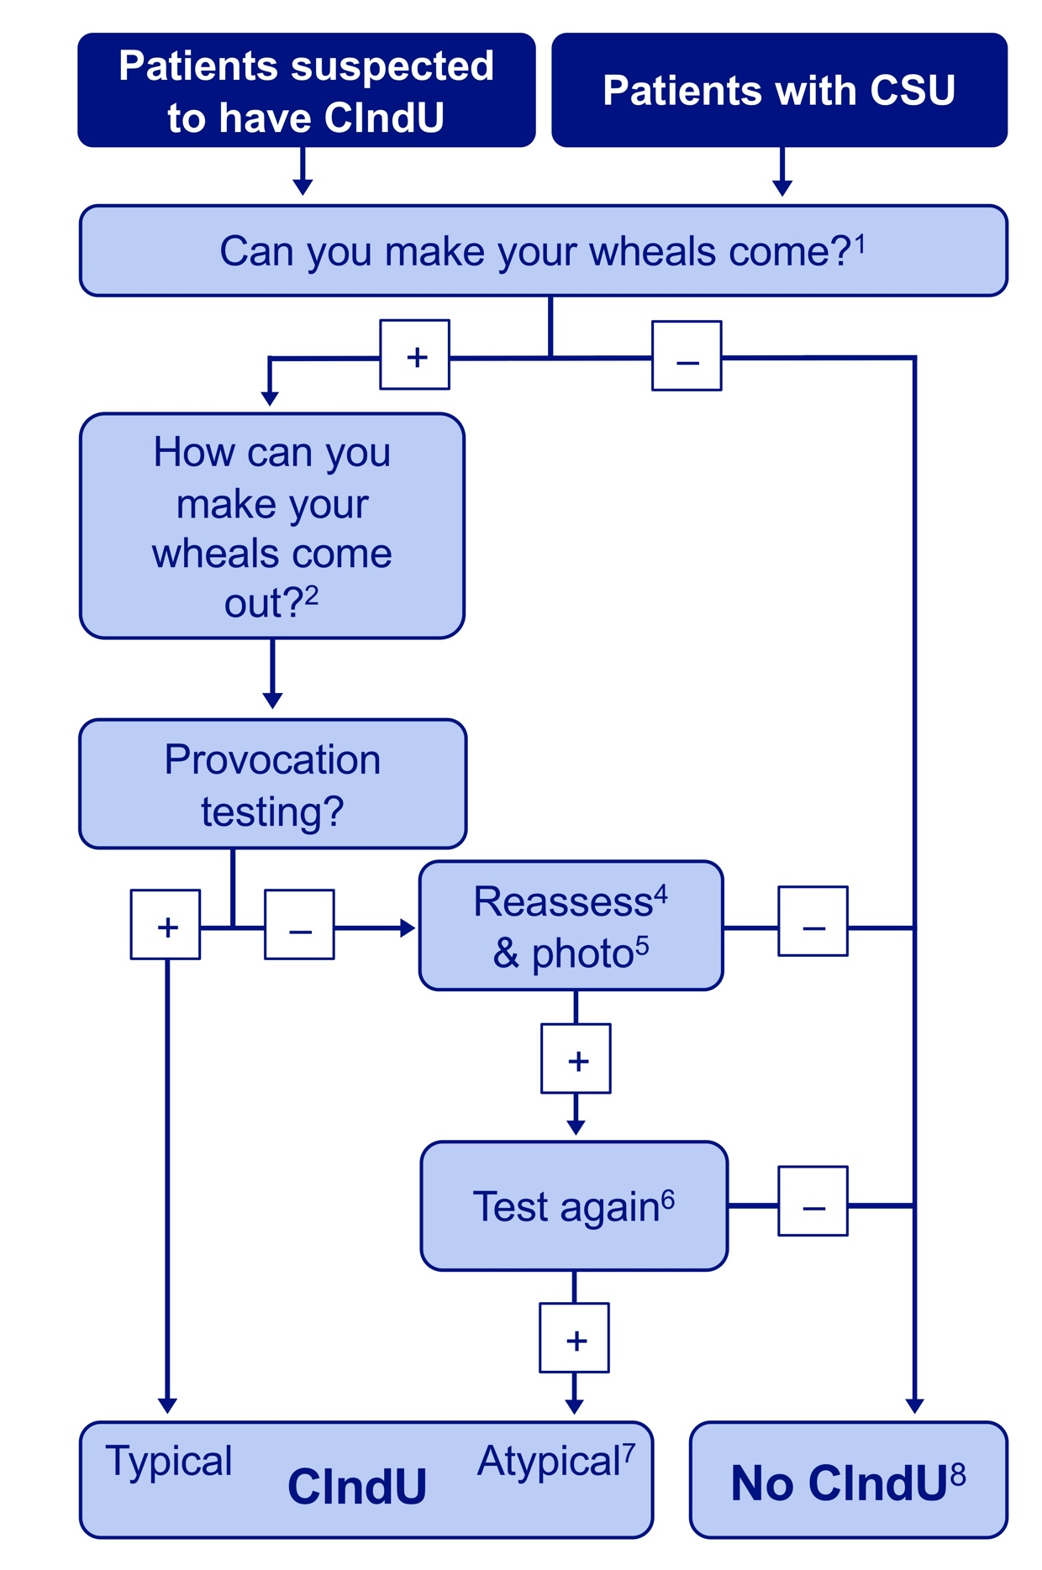
New Algorithms

